Slide 1
Asia Oceania Federation of Organizations for Medical Physics
Invites you to Celebrate
20th Anniversary of AFOMP
Monthly Webinars
(Time : 07:00-08:00 AM GMT)
8th Web-meeting : January 07, 2021 [Thursday]
Registration link
Register in advance for this meeting:
https://sanofi.zoom.com/meeting/register/tJArcOygrz4qH9crkFVo53I26lWj_7eOJVxQ
After registering, you will receive a confirmation email containing information about joining the meeting.
Title: Proton Therapy: Why and How?

Slide 2
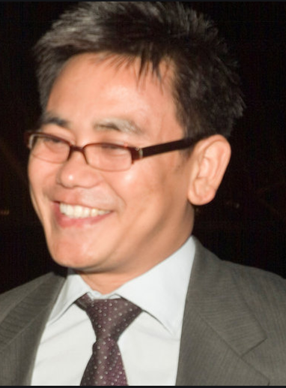
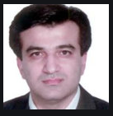
Asia Oceania Federation of Organizations for Medical Physics AFOMP 20th Anniversary
Eighth Webinar
January 07, 2021
Thursday 7–8 AM GMT
Presentation title
Proton Therapy: Why and How?
Speaker :
Dr. D.S Shamurailatpam
Moderator:
Dr M. A Mosleh-Shirazi
Dr. Dayanand S Shamurailatpam
Dr Mohammad Amin Mosleh-Shirazi

Slide 3
Asia Oceania Federation of Organizations for Medical Physics- AFOMP 20th Anniversary
AFOMP Monthly Webinar Series 2020
(Every first Thursday of the month, 07.00 – 08.00 AM GMT)
No | Date of Webinar | Speakers | Topics | Moderators
01 | 11 February 2021 | Dr. Eva Bezak | An overview of targeted beta and alpha therapies | Dr. Hajime Monzen
02 | 04 March 2021 | Dr. Chen Shou Chui | IAEA TRS-398 "Absorbed Dose Determination in External Beam Radiotherapy" | DR. V. Subramani
03 | 01 April 2021 | Dr. Hossein Mozdarani | Biological paradigms affecting radiotherapy outcome. | Dr Md Akhtaruzzaman
04 | 06 May 2021 | Prof. Hyun-Tai Chung | Basic principles, dose planning, advantages and quality assurance of a Gamma Knife radiosurgery | Dr. Supriyanto Ardjo Pawiro
05 | 03 June 2021 | Dr. Yibao Zhang | Knowledge-based planning: research and practice for cancer treatment | Dr Jeannie Hsiu Ding Wong

Slide 4
Continuous Professional Development (CPD) of Asia Oceania Federation of Organizations for Medical Physics (AFOMP) Monthly Webinar
Endorsed by Australasian College of Physical Scientists & Engineers in Medicine (ACPSEM)
Two points per webinar
Registration link:
https://jinshuju.net/f/IIvBFh
Finish within two hours after the webinar, no spreading please.

